Slide 1

Group Members:​
B.KARTHIK
S.JAIDEEP
J.SALMAN

Slide 2

INTRODUCTION
The Retail and Grocery domain requires effective management of inventory, suppliers, customer orders, employees, and product categories.
Efficient data handling helps businesses track sales and revenue, monitor product availability, and analyze operations.
This project simulates a mini grocery store database with interconnected entities like products, orders, and suppliers.
It offers hands-on experience in understanding data relationships and operational workflows.
Students will use SQL to extract and transform data, gaining valuable business insights.
The goal is to improve decision-making and operational efficiency through data analysis.

Slide 3
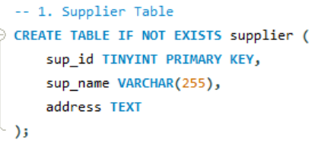
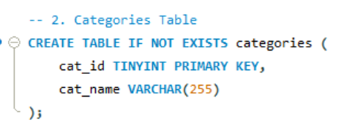
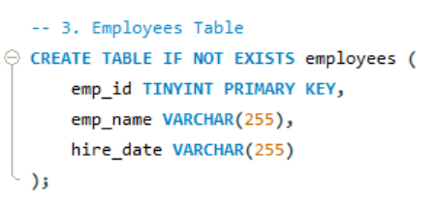
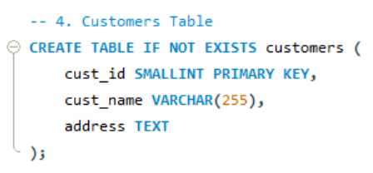
TABLE CREATION QUERIES

Slide 4
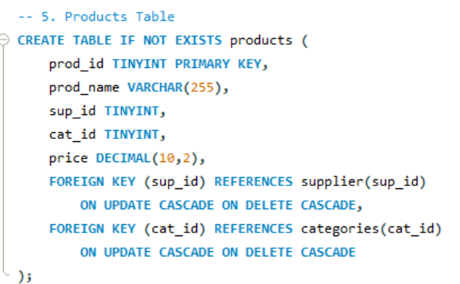
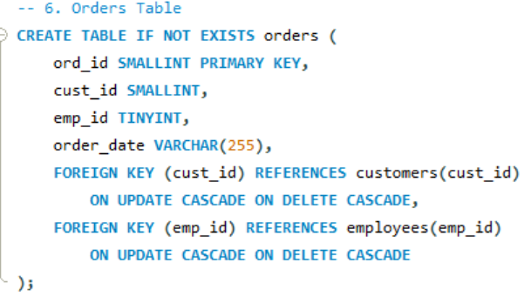
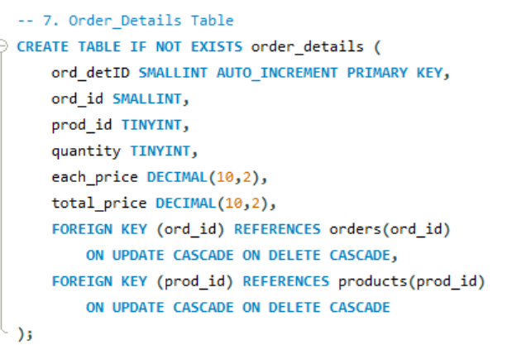
TABLE CREATION QUERIES

Slide 5

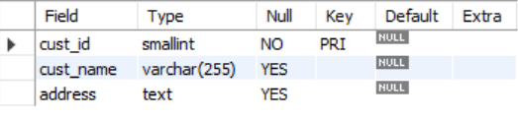
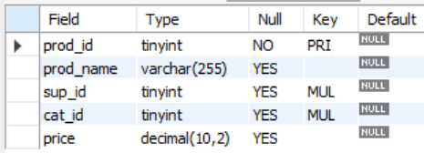
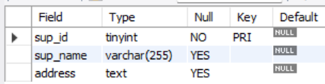
TABELS
Categories-Table
Customers-Table
Products Table
Suppliers Table

Slide 6
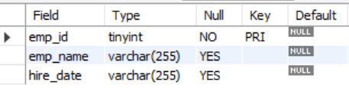
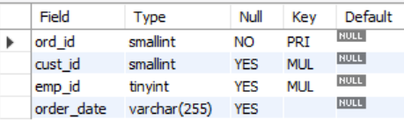
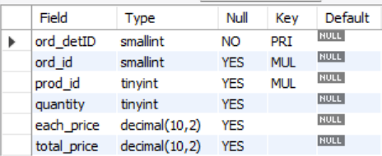
TABELS
Employees Table
Order Table
Order_details Table

Slide 7
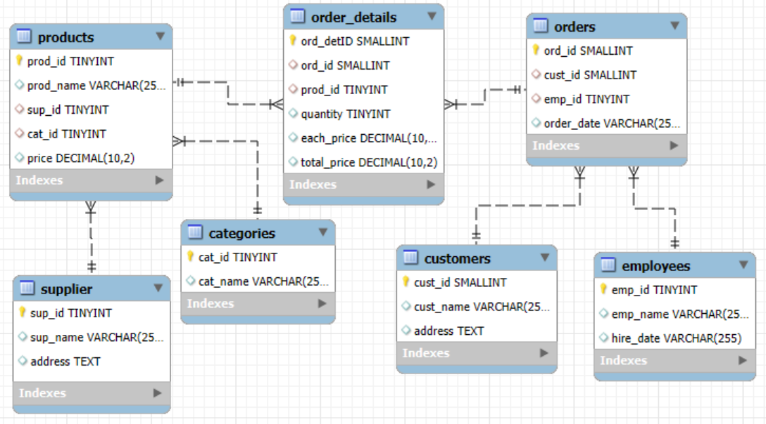
ER Diagram

Slide 8
Problem Statement
In the fast-paced setting of a retail grocery store, effectively handling and analyzing large amounts of data on products, suppliers, customers, and orders is vital for smooth operations and data-driven decision-making. This project focuses on designing and building a relational database system that records key store activities while allowing users to access and analyze information using SQL. The system will accommodate advanced queries to uncover important business insights, such as best-selling products, most valuable customers, and revenue trends, while also strengthening practical SQL skills like joins, aggregations, subqueries, and filtering.

Slide 9
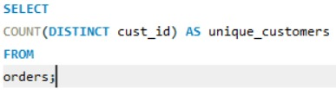

1.How many unique customers have placed orders?

Slide 10
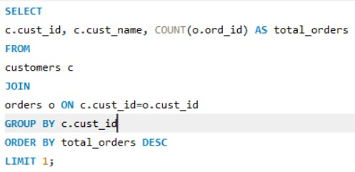

2.Which customers have placed the highest number of orders?

Slide 11
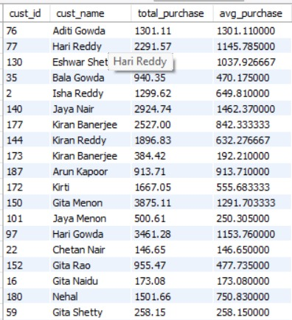
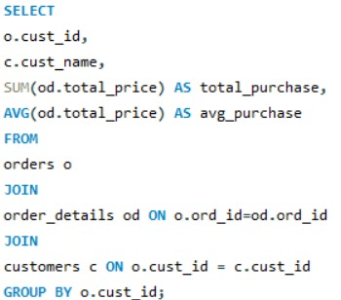
3. What is the total and average purchase value per customer?

Slide 12
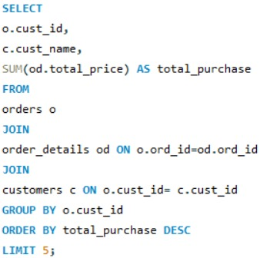
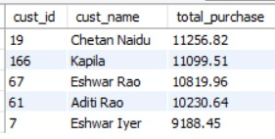
4.Who are the top 5 customers by total purchase amount?

Slide 13
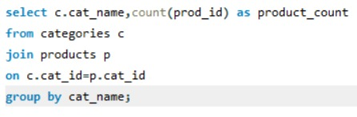
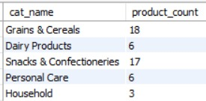
5. How many products exist in each category?

Slide 14
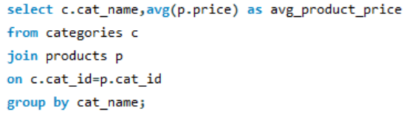
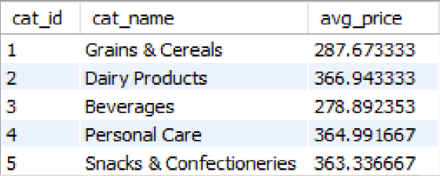
6. What is the average price of products by category?

Slide 15
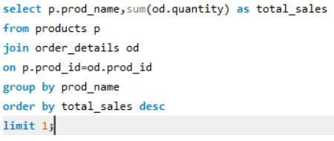

7. Which products have the highest total sales volume (by quantity)?

Slide 16
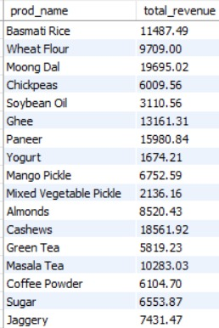
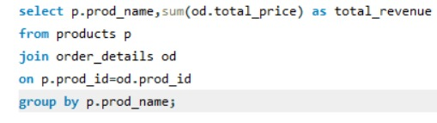
8. What is the total revenue generated by each product?

Slide 17
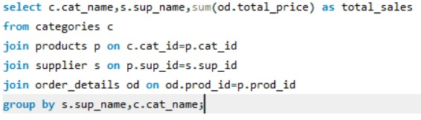
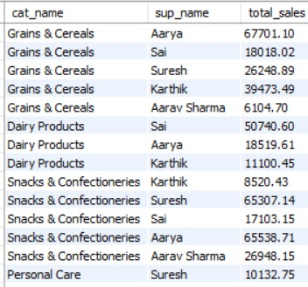
9. How do product sales vary by category and supplier?

Slide 18


10.How many orders have been placed in total ?

Slide 19
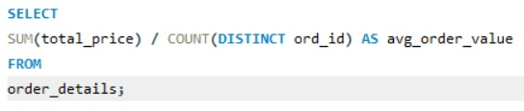

11. What is the average value per order ?

Slide 20
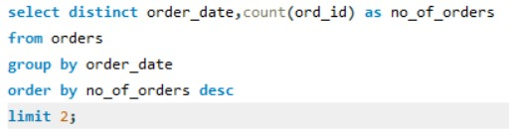

12. On which dates were the most orders placed ?

Slide 21
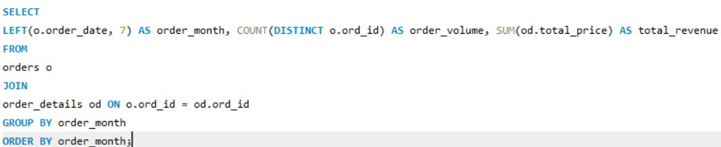
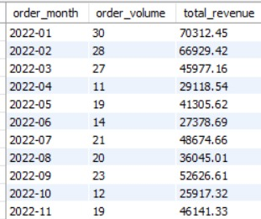
13. What are the monthly trends in order volume and revenue ?

Slide 22
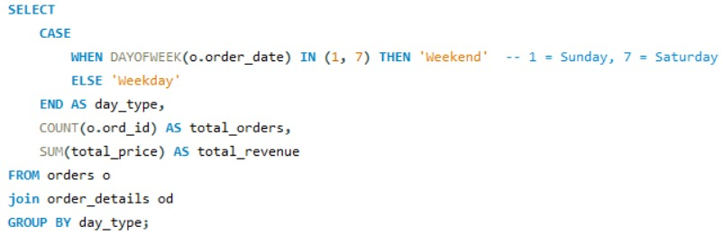

14. How do order patterns vary across weekdays and weekends?

Slide 23

15. How many suppliers are there in the database?

Slide 24
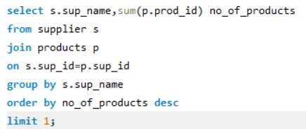

16. Which supplier provides the most products ?

Slide 25
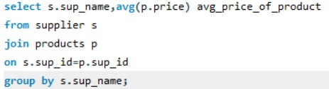
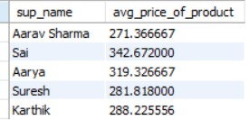
17. What is the average price of products from each supplier ?

Slide 26
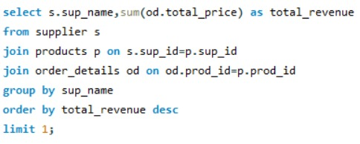

18. Which suppliers contribute the most to total product sales (by revenue) ?

Slide 27
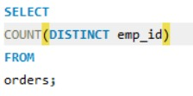

19. How many employees have processed orders?

Slide 28
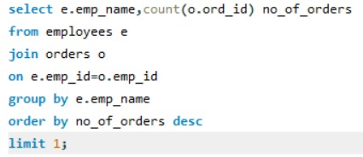

20. Which employees have handled the most orders?

Slide 29
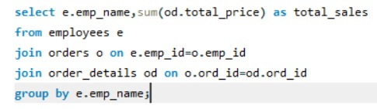
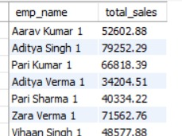
21. What is the total sales value processed by each employee?

Slide 30
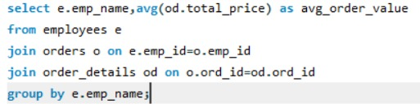
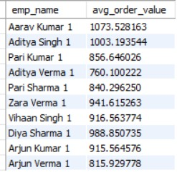
22. What is the average order value handled per employee?

Slide 31
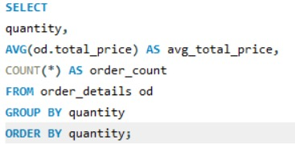
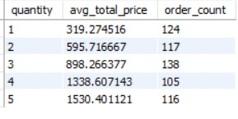
23. What is the relationship between quantity ordered and total price?

Slide 32
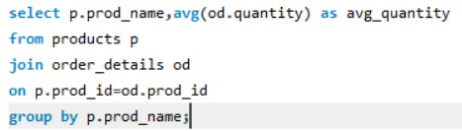
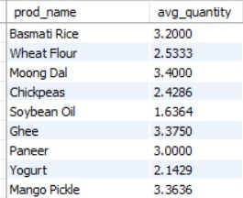
24. What is the average quantity ordered per product?

Slide 33
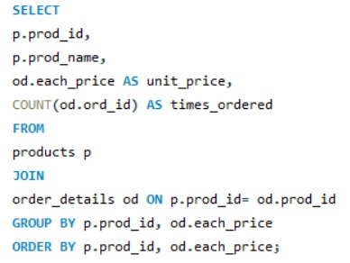
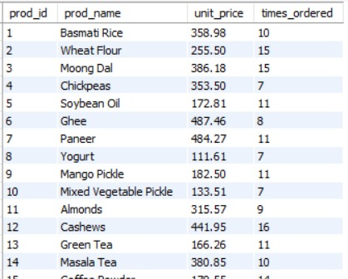
25. How does the unit price vary across products and orders?

Slide 34
THANK YOU

